Slide 1
Microsoft Power BI

Slide 2
Scaling Multi-tenant Solutions using Service Principal Profiles
Ted Pattison
Principal Program Manager
Power BI Customer Advisory Team (PBICAT)

Slide 3
Welcome to Power BI Dev Camp
Power BI Dev Camp Portal - https://powerbidevcamp.net

Slide 4
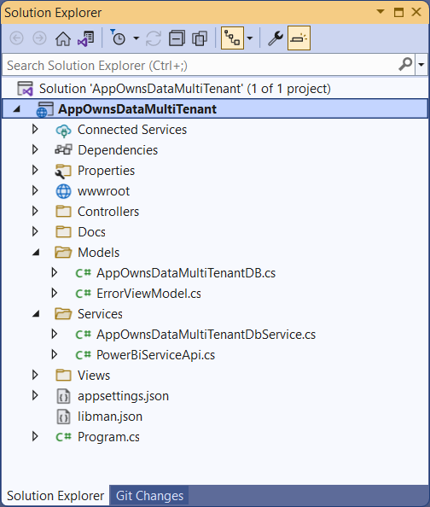
Developer Sample: AppOwnsDataMultiTenant
You can download and try out the sample code used in this webinar
Implemented as C#/.NET6 web application which uses the Power BI .NET SDK
Download this code from https://github.com/PowerBiDevCamp/AppOwnsDataMultiTenant

Slide 5
Agenda
Introduction to Service Principal Profiles
Creating and Managing Service Principal Profiles
Calling the Power BI REST API as a Service Principal Profile
Designing Multi-tenant Applications using Service Principal Profiles

Slide 6
Developing with App-Owns-Data Embedding
Best practices in App-Owns-Data embedding
Call Power BI REST API as service principal not as user
Avoid problems with MFA and managing password rotation
Requires code to provision customer tenants
create new workspace
import PBIX to create dataset
set datasource credentials
start refresh operations

Slide 7
Understanding the 1000 Workspace Limitation
Service principal cannot be member of more than 1000 workspaces
Purpose of limit is to maintain high levels of performance
Performance suffers as service principal is added to more workspaces
1000 workspace limitation is not enforced through code in Power BI Service
Observations about the 1000 workspace limit
Scenario is unsupported when service principal is member of 1000+ workspaces
Being member of 100 workspaces will perform better than 1000 workspaces
Being member of 10 workspaces will perform better than 100 workspaces
Optimal number of workspace memberships for performance reasons = 1

Slide 8
What Did We Do Before Service Principal Profiles?
Multi-tenant application designs used in the past
Single Service Principal
Service Principal Pooling
One Service Principal Per Customer Tenant

Slide 9


Solution 1 – Single Service Principal
Requires one-time creation of Azure AD application for service principal
Supported until you reach 1000 tenants
Less performant when service principal is member of 100s of workspaces
Service principal is owner of datasource credentials across all customer tenants
Multi-tenant Environment Power BI Service
Customer 1
Multi-tenant Application
Workspace for Customer 1 Tenant
Customer 2
Service
Principal
Workspace for Customer 2 Tenant
Customer 3
Workspace for Customer 3 Tenant
Customer N
Workspace for Customer N Tenant

Slide 10
Solution 2 –Service Principal Pooling
Requires occasional need to create new Azure AD applications as # of tenants increases
Can scale to any number of required tenants
Less performant when service principal is member of 100s of workspaces
Service principals are owner of datasource credentials across multiple customer tenants
Multi-tenant Environment Power BI Service
Customer 1
Multi-tenant Application
Workspace for Customer 1 Tenant
Service
Principal
Customer 2
Workspace for Customer 2 Tenant
Customer 3
Service
Principal
Workspace for Customer 3 Tenant
Customer N
Workspace for Customer N Tenant

Slide 11
Solution 3 – One Service Principal Per Customer Tenant
Requires need to continually create new Azure AD applications for new tenants
Can scale to any number of required tenants
Best Performance because service principal is only member of a single workspace
No service principal owns datasource credentials for more than one customer tenant
Multi-tenant Environment Power BI Service
Customer 1
Multi-tenant Application
Workspace for Customer 1 Tenant
Service
Principal
Customer 2
Workspace for Customer 2 Tenant
Service
Principal
Customer 3
Workspace for Customer 3 Tenant
Service
Principal
Customer N
Service
Principal
Workspace for Customer N Tenant

Slide 12
Comparing Solutions Before Service Principal Profiles
Each solution has strengths and weaknesses compared to others
 | Single Service Principal | Service Principal Pooling | Service Principal per Tenant
Azure AD Overhead | Low | Medium | High
Datasource isolation | None | Partial | Complete
Power BI API Performance | OK | OK | Optimized

Slide 13
Understanding Service Principal Profiles
Service principal profiles are created as local accounts created in Power BI Service
New Power BI Profiles API allows service principal to create service principal profiles
No limit on how many service principal profiles can be created by a single service principal
Service principal profiles are unknowns to Azure AD – it's a power BI thing!
Parent-child relationship exists between service principal and the profiles it creates
Service principal profiles are never stand-alone – they're always associated with service principal
Service principal profile can only be used by service principal which created it
Service principal profile not accessible from other service principals or users
Power BI Service
profile 1
Service
Principal
profile 2
profile 3

Slide 14
Designing with Service Principal Profiles
Service principal profile is first-class security principal in Power BI authorization system
Service principal can execute Power BI REST API calls under identity of service principal profile
Service principal profile can be added as workspace member
Service principal profile can create workspaces and set datasource credentials
Service principal profile can generate embed token for App-Owns-Data embedding
Multi-tenant Application
Workspace for Customer 1 Tenant
profile 1
Service
Principal
Workspace for Customer 2 Tenant
profile 2
profile 3
Workspace for Customer 3 Tenant

Slide 15
Service Principal Profile Per Customer Tenant
Requires one-time creation of Azure AD application for service principal
Can scale to any number of required tenants
Each service principal profiles owns datasource credentials for one customer tenant
Best Performance because service principal profile is member of a single workspace
Multi-tenant Environment Power BI Service
Customer 1
Multi-tenant Application
Workspace for Customer 1 Tenant
profile
Customer 2
Service
Principal
Workspace for Customer 2 Tenant
profile
Customer 3
profile
Workspace for Customer 3 Tenant
profile
Customer N
Workspace for Customer N Tenant

Slide 16







ISV App
AAD
users
tenants
Service principal
Power BI
Profiles
Main
Contoso1
Contoso2
report
Mapping in ISV DB
dataset
<params1>
<params2>
<params3>

Slide 17
Agenda
Introduction to Service Principal Profiles
Creating and Managing Service Principal Profiles
Calling the Power BI REST API as a Service Principal Profile
Designing Multi-tenant Applications using Service Principal Profiles

Slide 18
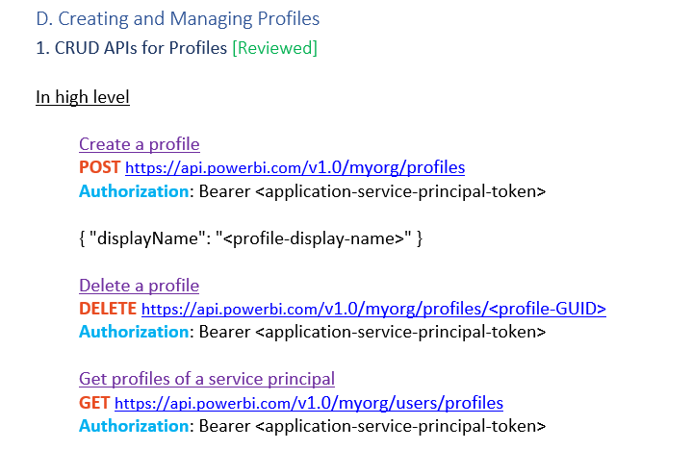

Slide 19
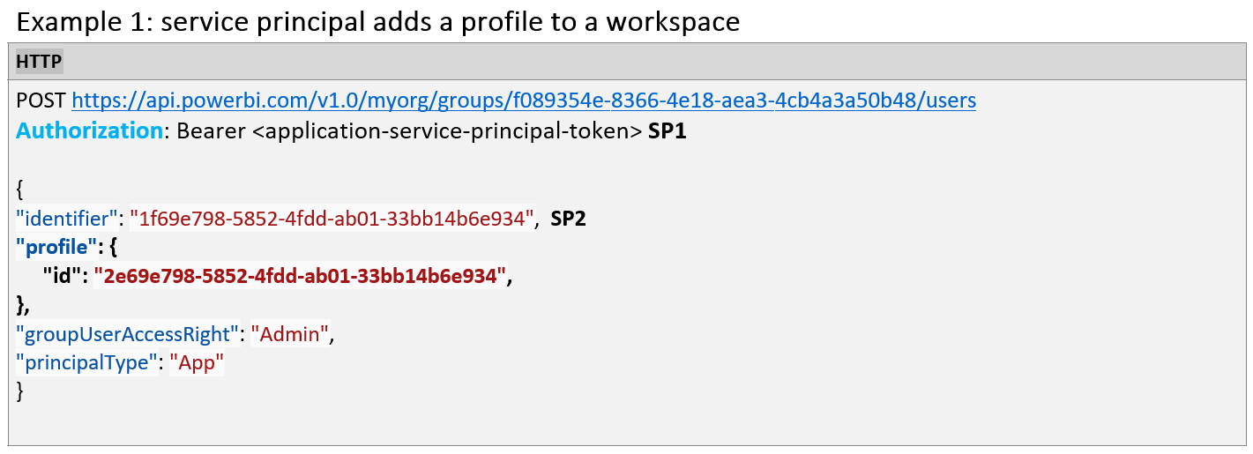
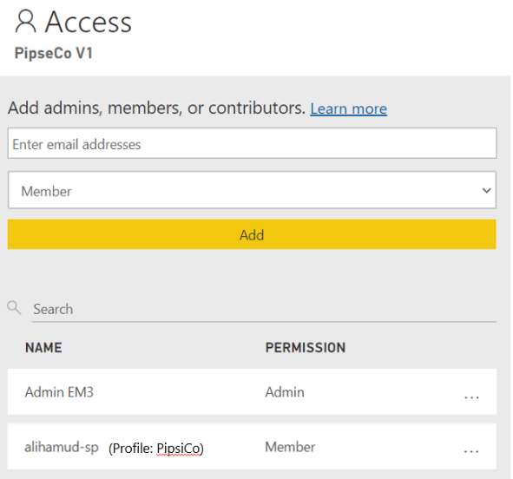
Profile-ABC

Slide 20
Agenda
Introduction to Service Principal Profiles
Creating and Managing Service Principal Profiles
Calling the Power BI REST API as a Service Principal Profile
Designing Multi-tenant Applications using Service Principal Profiles

Slide 21
Agenda
Introduction to Service Principal Profiles
Creating and Managing Service Principal Profiles
Calling the Power BI REST API as a Service Principal Profile
Designing Multi-tenant Applications using Service Principal Profiles

Slide 22
Summary
Introduction to Service Principal Profiles
Creating and Managing Service Principal Profiles
Calling the Power BI REST API as a Service Principal Profile
Designing Multi-tenant Applications using Service Principal Profiles

Slide 23
Microsoft Power BI
Questions?

Slide 24
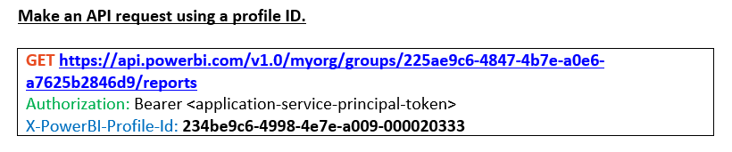
Power BI will authorize the token and check the profile permissions.

Slide 25
Profiles are not standalone themselves; they are tied to a service principal. it's basically, a restriction of what SPN can do.
Turned on by tenant admin FS. Default: false.
A profile can be created and used by service principals only.
A profile cannot be shared between principals.
Only public APIs area allowed to be used by profiles.
Profiles can generate Embed Token that can be used later
Add a new profile
POST /v1.0/myorg/profiles
Authorization: Bearer <application-service-principal-token>
Add a user to a workspace (called by someone who has access).
POST /v1.0/myorg/groups/225ae9c6-4847-4b7e-a0e6-a7625b2846d9/users
Authorization: Bearer <application-service-principal-token>
Make an API request with using the Local User
GET /v1.0/myorg/groups/225ae9c6-4847-4b7e-a0e6-a7625b2846d9/reports
Authorization: Bearer <application-service-principal-token>
X-PowerBI-Profile-Id: 112-2222-3333-4444
Profile-ABC

Slide 26
A local user per customer
ISV application maintains one service principal in AAD.

Slide 27




First you build your content and publish it to golden workspace.
Golden Workspace
Sample Data Dataset
Report 1
Report 2
Report 3
Admin
Content publishers have admin access
Content publishers

Slide 28


Contributor*
Onboard new tenant
Golden Workspace
Create a Profile
Test Dataset
Profile 1
Add the Profile as contributor
to the golden workspace.
Report 1
Admin
Using Profile 1:
Report 2
Tenant 1 Workspace
Create a new workspace for
the new tenant.
Report 3
Test Dataset
Publish the golden content
into the new workspace.
(Import API for automation)
Admin
Report 1
Report 2
Content publishers
Report 3
Contributor*: Note that you do not necessarily need this access if you use service principal to import directly from local files. You will need contributor access only if you are creating dashboards in golden workspace, and you want to clone them for all tenants
Step can be automated

Slide 29


Contributor*
Onboard new tenant
Golden Workspace
Create a Profile
Test Dataset
Profile 1
Add the Profile as contributor
to the golden workspace.
Report 1
Admin
Using Profile 1:
Report 2
Tenant 1 Workspace
Create a new workspace for
the new tenant.
Report 3
Tenant 1 Dataset
Publish the golden content
into the new workspace.
(Import API for automation)
Admin
Report 1
Report 2
Update the dataset
to connect to the real
Tenant data
(Update datasource and
credentials)
Content publishers
Report 3
Capacity Assigned
Assign new workspace to
capacity
Step can be automated

Slide 30
Contributor*
Golden Workspace
Test Dataset
Profile 1
Profile 2
Report 1
Admin
Admin
Report 2
Tenant 1 Workspace
Tenant 2 Workspace
Report 3
Tenant 1 Dataset
Tenant 2 Dataset
Admin
Report 1
Report 1
Report 2
Report 2
Content publishers
Report 3
Report 3
Capacity Assigned
Capacity Assigned

Slide 31
Feedback

Slide 32
Feedback: Complexity
Profiles vs. AAD service principals
Questions:
Is the profiles solutions easier than creating multiple service principals in AAD?
What reasons makes you avoid using the profiles approach?

Slide 33
Feedback: Identity Isolation
do you hear from your customers a need for identity isolation?
Will this logical partitioning satisfy them?

Slide 34
Feedback: API
Is it intuitive?
Do you see a problem with the Profile ID passed in the HTTP headers?
Add a new profile
POST /v1.0/myorg/profiles
Authorization: Bearer <application-service-principal-token>
-> Returns a GUID: 111bbcc-0101-0101-a0a0-a0a0a0a0a0
Add a profile to a workspace (called by someone who has access).
POST /v1.0/myorg/groups/225ae9c6-4847-4b7e-a0e6-a7625b2846d9/users
Authorization: Bearer <application-service-principal-token>
{ profileId: “111bbcc-0101-0101-a0a0-a0a0a0a0a0” }
Make an API request with using the Profile
GET /v1.0/myorg/groups/225ae9c6-4847-4b7e-a0e6-a7625b2846d9/reports
Authorization: Bearer <application-service-principal-token>
X-PowerBI-Profile-Id: 111bbcc-0101-0101-a0a0-a0a0a0a0a0

Slide 35
Feedback: Easier deployment
Do you see a need for an SDK that wraps the Power BI content management, especially in a multi-tenant app?

Slide 36
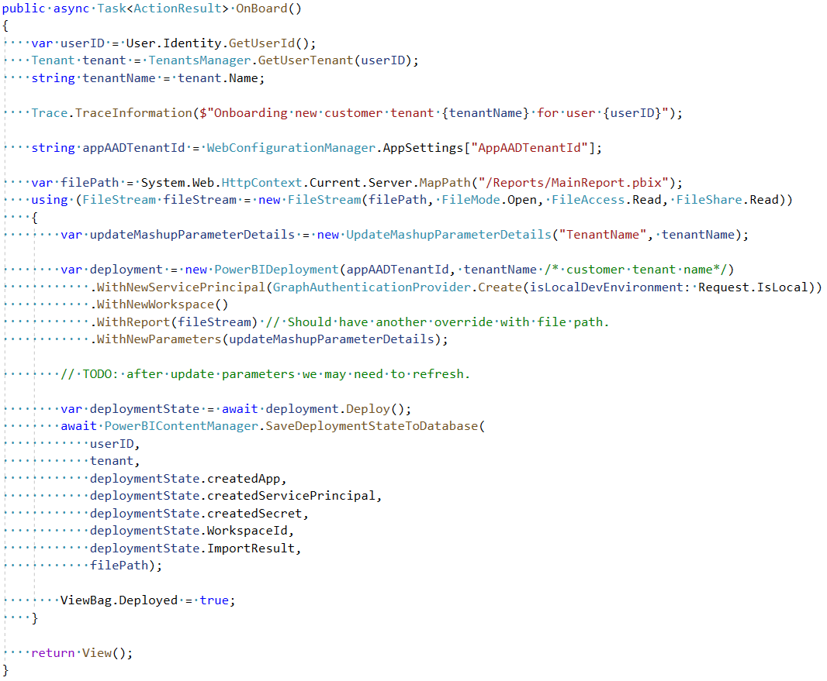
For each new tenant, ISV code should create a new SP.
ISV code should save in the DB/KeyVault: the created AAD app, SP, secret, workspace and report

Slide 37
Feedback: Naming
Do you see a problem with the name “Profile”?
What do you think about “Partition”?
Other names?

